Slide 1
SPM PRESENTATION
G6

Slide 2
Functionalities
Do you plan to drop/add any functionalities?
Not dropping any functionalities
Adding quality of life improvements:
An additional warning pop-up during dropping of a section to remind the student of the refundable e-cash.
Able to filter courses by Date, Time, Course ID, and instructor
Able to view sections of successful bids on landing page

Slide 3
Functionalities
Do you plan to use any PHP frameworks?
No, planning to use PHP frameworks but bootstrap 4
Did you manage to finish login + 1 functionality?
Yes, the functionalities are ?
Login (to the Landing Page)
Bid for a Section (the restrictions are not implemented. However, if they bid for a section of a particular course, that course will be removed from the bidding list)

Slide 4
SPMisgreat!
IP Address: 18.216.225.229
Is the admin password for our cloud deployment

Slide 5
Schedule

Slide 6
Schedule
Week 3:
Team meeting to discuss job scope, project requirements
Brainstorming UI and site mapping
Trello and Google sheets
Week 4:
Assignment of Pair Programmes
Review of wireframe designs and comparison against functional document (Wiki)
Begin coding
DAO and Bootstrap
Basic pages (Login admin page)

Slide 7
Schedule
Week 5:
Wireframe updates based on coding logic missed before
Code unaffected pages:
“User bid and pending” page
“Add bids” page
Week 6:
Preparation for PM review
Determining the project requirements
Updating of wireframes for recently discovered functional cases
Preparing PM Review slides and content
Consolidating and reviewing current operational pages of the project for final preparations

Slide 8
Schedule
Week 7, (Iteration 2) :
Discuss feedback or questions of the PM review
Re-evaluate backend structure and code JSON APIs.
Next round of coding
Implementation of new database
Test all completed pages against new database (Login and Admin) bids” page
Week 8 (Recess Week):
Finish coding the rest of the pages
Layout
Drop section
Landing page
Add bid page

Slide 9
Schedule
Week 9
Discuss feedback or questions of the PM review
Re-evaluate backend structure and code JSON APIs.
Next round of coding
Implementation of new database
Test all completed pages against new database (Login and Admin) bids” page

Slide 10
Schedule
Week 10 (Bug fixes and functionality checks):
Consolidation of all pages
Make sure that each page is functional in relation to the other
Go through bug fixes. Ones that are too difficult are added to the bug matrix
Implement additional functionalities on copied files for next release.

Slide 11
Schedule
Week 11 (Iteration 4, UAT):
Preparation of UAT
Run test cases manually
Run test cases automatically using JSON API
Time allocated for fixes
Consolidation of any logistics required (Laptop, Ethernet Cable... etc.)
Push and test any new functionalities and release to UAT

Slide 12
Iteration Schedule
Iteration # | Date
0 | 31st August - 18th September
1 | 19th September - 3rd October
2 | 4th October - 17th October
3 | 18th October - 31st October
4 | 1st November - 14th November
5 | 15th November - 21st November

Slide 13
Project Milestones
Iteration # | Milestones
0 | Understanding of functionality and basic pages
1 | PM Review
2 | Application Demo and Progress Update
3 | All functional coding work completed
4 | UAT presentation

Slide 14
Iteration breakdown
Iteration # | Details
0 | Administrative work: Understanding the scope of the project Scheduling Understanding the structure of our product Looking at wireframes and how they link Update according to recent discussions First round of coding Database and Bootstrap and simple pages

Slide 15
Iteration breakdown (cont.)
Iteration # | Details
1 | Unplanned changes in functionality Update of design Second round of coding PM review preparation
2 | Administrative work: Mid project review Consolidation and synchronisation of team Third round of coding (intensive)

Slide 16
Iteration breakdown (cont.)
Iteration # | Details
3 | Preparation for Application Demo and Progress Update Consolidation of pages, bug fixes Preparation of additional functionalities for iterations
4 | UAT Preparation

Slide 17
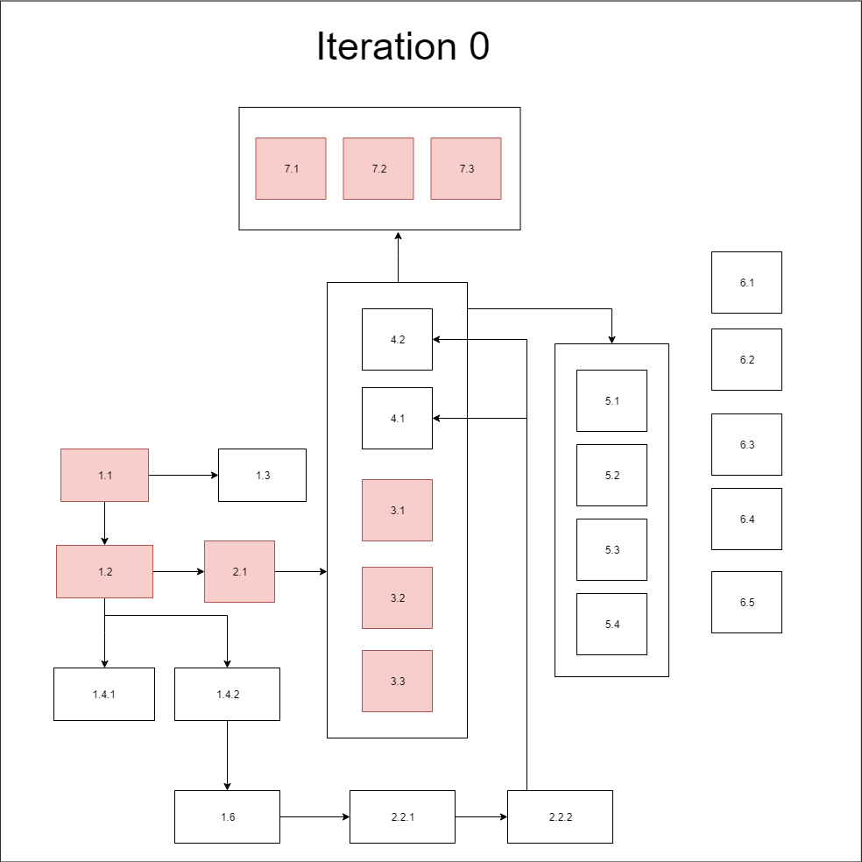
Slack Time: 10.083 hours

Slide 18
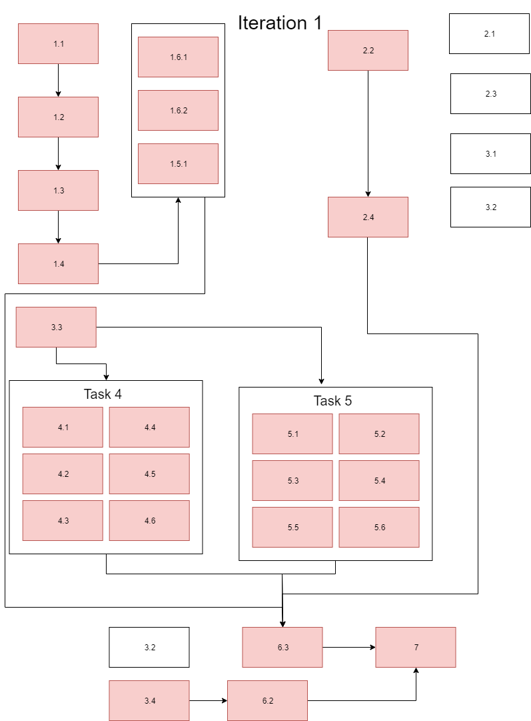
Slack Time:
7 hours

Slide 19
Testcase &
Bug Metric

Slide 20


Testcases & Bug Metrics
Login
Bootstrap Upload

Slide 21
Testcase Planning
Row | Description | Column | Result to Happen
Row 2 | Delete exam date | exam date | Fail
Row 3 | Alphanumeric exam date | exam date | Fail
Row 4 | Date with space | exam date | Fail
Row 5 | Date with extra numbers | exam date | Fail
Row 6 | Incorrect Exam start 12.01 | exam start | Fail
Row 7 | Delete exam start | exam start | Fail
Row 8 | Alphanumeric exam starts | exam start | Fail
Row 9 | Edit exam starts value and re-edit back to normal | exam start | Pass

Slide 22
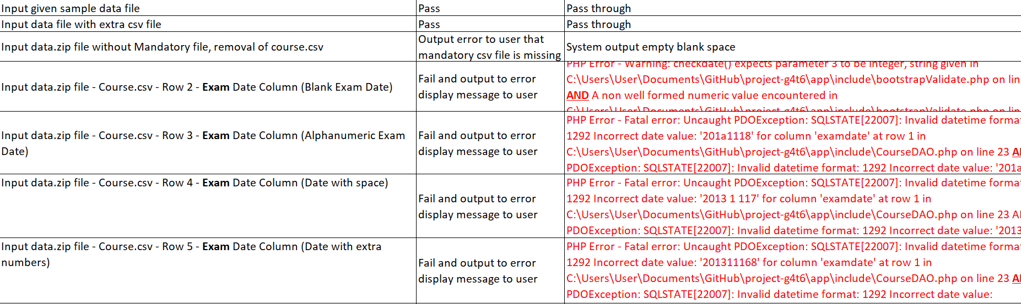
Testcase Outcome
Screenshot sample

Slide 23
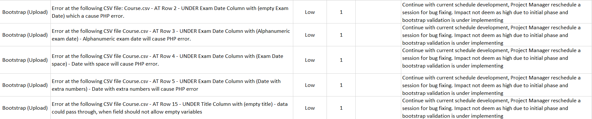
Bug Metrics Outcome
Screenshot sample

Slide 24
Roles and Responsibilities

Slide 25
Roles and Responsibilities
Iteration | Week | Project Manager
1 | Week 5 to Week 6 | Matthew
2 | Week 7 to Week 8 | Vittorio
3 | Week 9 to Week 10 | Da Eun
4 | Week 11 to Week 12 | Brendon
5 | Week 13 | Sheng Qin

Slide 26
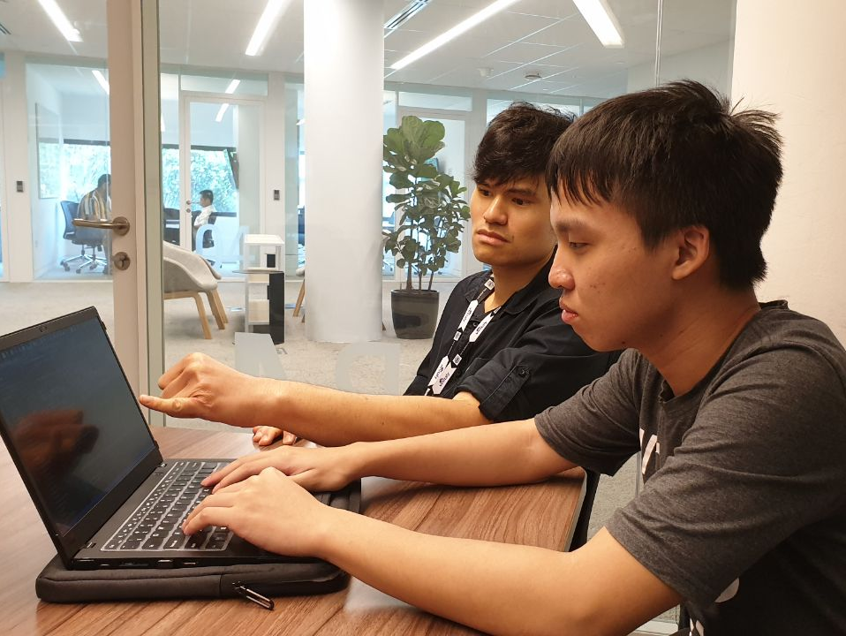
Place your screenshot here
Pair
Programming

Slide 27
Pair Programming Rotation
Iteration | Week | Project Manager | Programming pairs |  | Date
1 | Week 5 to Week 6 | Matthew | Sheng Qin and Vittorio | Brendon and DaEun | 15th Sep- 28th Sep
2 | Week 7 to Week 8 | Vittorio | Matthew and Brendon | Sheng Qin and DaEun | 29th Sep- 12th Oct
3 | Week 9 to Week 10 | Da Eun | Sheng Qin and Brendon | Vittorio and Matthew | 13th Oct - 26th Oct
4 | Week 11 to Week 12 | Brendon | Matthew and DaEun | Sheng Qin and Vittorio | 27th Oct - 9th Nov
5 | Week 13 | Sheng Qin | Da Eun and Brendon | Matthew and Vittorio | 10th Nov- 16th Nov

Slide 28
Pair Programming Tasks
Task | Members involved | Start time | End time
Code DAO for the various tables | DaEun, Brendon | 9/9/2019 12:00 | 9/9/2019 13:00
Code user/admin login page without bootstrap, but with reference to an imported database with sample data | DaEun, Brendon | 9/9/2019 13:00 | 9/9/2019 13:45
Create Database | DaEun, Brendon | 9/9/2019 13:45 | 9/9/2019 15:00
Code user bid and pending page in accordance with hard-coded information | Sheng Qin, Vittorio | 10/9/2019 10:00 | 10/9/2019 13:00

Slide 29
Special thanks to all the people who made and released these awesome resources for free:
Presentation template by SlidesCarnival
Photographs by Unsplash

Slide 30
Thank you!

